Slide 1
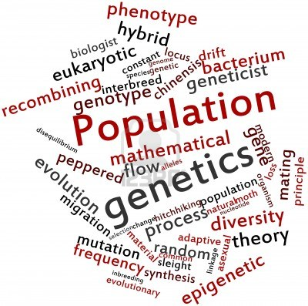

Population Genetics
Interactive Case Discussion

Slide 2
Learning Objectives
By the end of this session, students should be able to…
Illustrate how historical human migration patterns have contributed to genetic variation observed in modern populations.
Differentiate between population subgroups defined by racial categories or geographic ancestry in terms of genetic variation.
Use the principles of population genetics (e.g. founder effect, Hardy-Weinberg equilibrium, selection pressure) to predict frequencies of alleles and genotypes in a given population.
Evaluate the significance of identifying the presence of disease alleles on the health care system and on individuals acquiring this information directly, in the absence of the guidance of a health care professional.
Assess the implications of evolving genetic testing technologies on yielding false negative results and the validity of the duty to re-contact concept.
Notes:
Our learning objectives goals specific to this discussion exercise are to:
4. Evaluate the significance of identifying the presence of disease alleles on the health care system and on individuals acquiring this information directly, in the absence of the guidance of a health care professional.
5. Assess the implications of evolving genetic testing technologies on yielding false negative results and the validity of the duty to recontact concept.

Slide 3
Population Genetics Roadmap
Intro to Genetic Testing
Case 1
Variants of Unknown Significance
Duty to Recontact
Case 2
Incidental Findings
Notes:
Our roadmap for today’s discussion includes an introduction to genetic testing and 2 cases that will illustrate topics in population genetics: variants of unknown significance, duty to recontact, and incidental findings. The concepts we covered in the pre-class assignment we will apply to clinical relevant examples in today’s world of genetic testing.

Slide 4
How can an individual interested in their genetic predispositions access genetic testing for clinical decision-making?
Notes:
Who can tell me how an individual can access genetic testing?

Slide 5
2 main approaches to genetic testing
Direct To Consumer Pros | Direct To Consumer Cons
can ask multiple genetic “questions” | - might uncover unexpected results
usually less expensive
shorter time frame
genome-wide strategies are better for individuals who are adopted | - may not test the common mutations of the non-majority
information provided directly to patient, does not involve insurance company or employer | - information provided directly to patient, does not involve genetic counselor
Notes:
Traditional paradigm Pros: information interpreted through genetic counselor
Traditional paradigm Cons: addresses one genetic question, usually, slower (appointment times), more expensive, not as good for time sensitive clinical decision-making. Let’s explore these 2 main platforms of genetic testing further in depth using clinical cases.

Slide 6
2 main approaches to genetic testing
Direct To Consumer Pros | Direct To Consumer Cons | Genetic Counselor Pros | Genetic Counselor Cons
can ask multiple genetic “questions” | - might uncover unexpected results | - only one genetic “question”, usually | - only one genetic “question”, usually
usually less expensive |  |  | - often more expensive
shorter time frame |  |  | - long wait for appointments
genome-wide strategies are better for individuals who are adopted | - may not test the common mutations of the non-majority
information provided directly to patient, does not involve insurance company or employer | - information provided directly to patient, does not involve genetic counselor | - information interpreted through genetic counselor | - not optimal for making time-sensitive clinical decisions
Notes:
Traditional paradigm Pros: information interpreted through genetic counselor
Traditional paradigm Cons: addresses one genetic question, usually, slower (appointment times), more expensive, not as good for time sensitive clinical decision-making. Let’s explore these 2 main platforms of genetic testing further in depth using clinical cases.

Slide 7
Case 1
Dominique is a 32 year old female with environmental allergies and no other past medical history. She is of African-American descent and has a strong family history of breast cancer, including her mother, who was diagnosed with breast cancer at 32. Dominique is indicated by the red arrow on the pedigree.
Is it a broken or unbroken chain of descent?
Who is affected?
Who is transmitting?
What genetic mutation may be traveling in this family?
breast cancer
dx 45 y
d. 54 y
bilateral
breast cancer
dx 37 y and 42 y
currently 68 y
prostate
cancer
dx 65 y
currently 65 y
breast cancer
dx 32 y
currently 62 y
breast cancer
dx 28 y
currently 30 y
Notes:
Let’s ask our standard pedigree questions.
is it broken vs. unbroken?
Who is affected?
Who is transmitting?
What genetic mutation may be traveling in this family? → BRCA mutation

Slide 8
Class poll
What is Dominique’s risk of having inherited the gene mutation in this pedigree that predisposes an individual to hereditary early-onset breast cancer?
0
0.25
0.5
0.6667
1
breast cancer
dx 45 y
d. 54 y
bilateral
breast cancer
dx 37 y and 42 y
currently 68 y
prostate
cancer
dx 65 y
currently 65 y
breast cancer
dx 32 y
currently 62 y
breast cancer
dx 28 y
currently 30 y

Slide 9
Autosomal Dominant calculation
Affected Parent
 | A | a
a | Aa Affected Child | aa Normal Child
a | Aa Affected Child | aa Normal Child
Correct answer: 50% chance of inheriting the same mutation
Normal Parent
Notes:
BRCA risk calculation

Slide 10
The case continues…
Dominique would like to know with 100% certainty if she has the BRCA1 or BRCA2 gene mutations that increase the risk of early-onset breast cancer.
Women of African descent with a family history of breast or ovarian cancer were significantly less likely to undergo genetic counseling for BRCA1/2 testing than were Caucasian women with a family history of breast or ovarian cancer (odds ratio: 0.22).
This association persisted after adjustment for SES, breast and ovarian cancer risk perception and worry, attitudes about the risks and benefits of BRCA1/2 testing, and PCP discussion of BRCA1/2 testing.
Racial Differences in the Use of BRCA1/2 Testing Among Women With a Family History of Breast or Ovarian Cancer
Armstrong K, et al. JAMA.2005;293(14):1729-1736.
Notes:
According to Armstrong et al’s 2005 JAMA article shown below, addressing differences in BRCA testing, women of African descent with a family history of breast or ovarian cancer were significantly less likely to undergo genetic counseling for BRCA1/2 testing than were Caucasian women with a family history of breast or ovarian cancer (odds ratio, 0.22). This association persisted after adjustment for probability of BRCA1/2 mutation, socioeconomic characteristics, breast and ovarian cancer risk perception and worry, attitudes about the risks and benefits of BRCA1/2 testing, and primary care physician discussion of BRCA1/2 testing.

Slide 11


Think about this question, then discuss with the person sitting next to you, and then prepare to share your answer with the class…
If you were Dominique, which method of genetic testing would you employ:
use a direct to consumer genetic testing platform that tests for limited common mutations and polymorphisms
get tested for an individual gene mutation related to a clinical question through a genetic counselor and why?
Image retrieved from http://www.23andme.com
on July 25, 2013. © 23andMe, Inc. 2007-2013. All rights reserved; distributed pursuant to a Limited License from 23andMe.
Image retrieved from http://www.ngsc.org
on July 25, 2013. Permission received from NGSC.
Notes:
2 minutes to talk…looking back at me
Is anyone willing to share what your preferred testing option would be and why?
No financial ties to 23andMe!

Slide 12
Dominique decides to consult a medical geneticist and have her BRCA1 and BRCA2 genes sequenced
1994: Myriad Genetics sequences BRCA1 and 2
Myriad obtains patent on deleterious BRCA mutations
2013: Supreme Court rules that naturally- occurring DNA can’t be patented while synthetic DNA can
These patents initially allowed Myriad Genetics to create a monopoly on diagnostic BRCA mutation testing.
A limited number of other deleterious BRCA mutations that had been found through other avenues are present in other forms of genetic testing, such as direct-to-consumer genetic testing via companies like 23andMe.
However, many Myriad-patented mutations were not included in the DTC tests for common mutations and polymorphisms that increase the risk for hereditary breast cancer. Thus, non-Myriad strategies were not considered diagnostic because they did not provide comprehensive risk assessment. In light of the Supreme Court ruling in June 2013, this may change.
The ethics of “patenting” genes is controversial.
Notes:
In 1994, researchers at Myriad Genetics (a company co-owned by scientists from University of Utah and Harvard University) sequenced BRCA1 and BRCA2 and obtained a patent on the gene mutations they found to be associated with increased risk for breast cancer. These patents allow Myriad Genetics to be the clinical provider of Myriad “patented” specific BRCA mutation testing. There are many other deleterious BRCA mutations that have been found through academic research, publicly available, that are present in other forms of genetic testing, such as direct-to-consumer genetic testing via companies like 23andMe. However, many Myriad patented mutations are not included in the DTC tests for common mutations and polymorphisms that increase the risk for hereditary breast cancer.
The ethics of “patenting” genes is controversial. A federal appeals court case recently ruled in favor of Myriad Genetics in November 2012: the central legal issue was whether isolated genes are different from ones in the body to allow them to be patented. “The isolated DNA molecules before us are not found in nature,” wrote Judge Alan D. Lourie, who was in the majority. “They are obtained in the laboratory and are man-made, the product of human ingenuity”.
What do you think about this legal decision?
Justice Clarence Thomas, who authored the Supreme court's opinion, said: "Genes and the information they encode are not patent eligible... simply because they have been isolated from the surrounding genetic material."
we didn’t design the human genome, we are just “reading it”

Slide 13
Dominique’s Test Results
Dominique’s results reveal that she has a variant of unknown significance (VUS) in the coding region of BRCA1.
VUSs (also termed unclassified variants) are sequence variations (usually, missense mutations) in a gene where the effect of the sequence change on the function of the protein is not known.
Between 10-15% of individuals undergoing genetic testing for BRCA1 and BRCA2 mutations will be found to have a VUS.
VUS are more common in individuals of African descent with frequencies as high as 46%.
Notes:
VUSs (also termed unclassified variants) are sequence variations in a gene where the effect of the sequence change on the function of the protein is not known. Many of these variants are missense mutations that result in a single amino acid change. However, the functional significance of the thousands of missense mutations identified to date in BRCA1 and BRCA2 is unclear – most are probably benign but determining the clinical significance of a specific VUS with certainty (which is what any women or men with a family history of breast cancer would want to know) is difficult.
VUSs are inherent issues in all types of genetic testing, but are particularly problematic in testing BRCA1 and BRCA2 because these genes are very large. Between 10% and 15% of individuals undergoing genetic testing for BRCA1 and BRCA2 mutations will be found to have a VUS. Important for our case, variants of unknown significance are more common in individuals of African descent with frequencies as high as 46%.

Slide 14
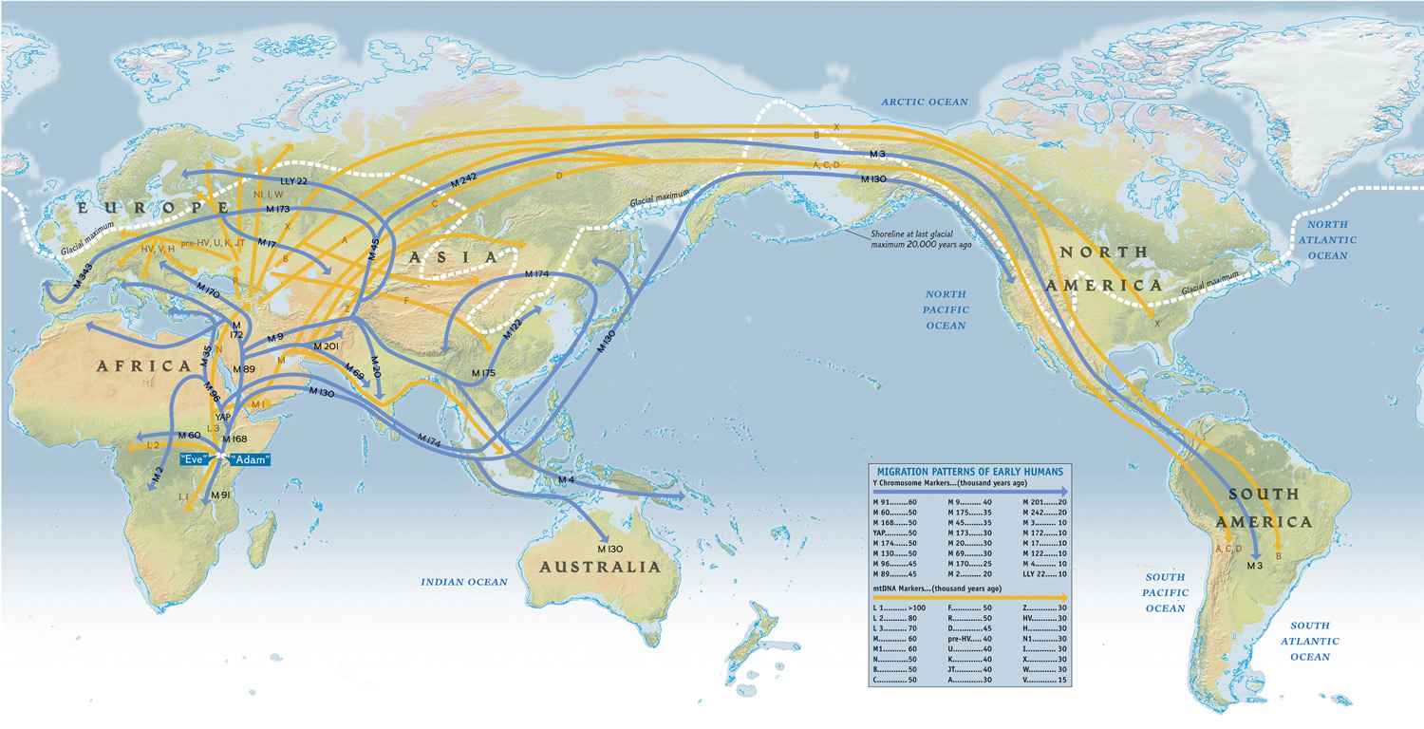
What is one reason why individuals of African descent are more likely to have more variants of unknown significance?
The Genographic Project
Image retrieved from http://3cpg.cornell.edu/index.cfm/page/AncestryProject/AncestryEventsSpr2011.html on July 25, 2013. Permission received from National Geographic.
Notes:
African was the birthplace of humankind – and thus has the highest degree of genetic variation and thus more variants of unknown significance than those of other geographic ancestries.
Also, many of the mutation-discovery studies were done in other ancestral populations that do not reflect the genetic diversity present in the African population.
Jakobsson et al. Nature 451, 998-1003

Slide 15
Class poll:
Dominique meets with her medical geneticist to discuss options regarding her BRCA1 test results. If you were in Dominique’s shoes, what would you do?
Watchful waiting
Ask her affected mother to undergo the same genetic testing she did
Prophylactic procedure: Mastectomy/oophorectomy
Increased surveillance: Mammography every 6 months
Notes:
prophylactic procedure: talked in class – not everyone goes for the pro procedure

Slide 16
Dominique asks her mother to undergo the Myriad Genetics test and the results showed that she does not have a known deleterious mutation in BRCA1 or BRCA2 but the same variant of unknown significance as Dominique.
Remember: recommended to test the proband, or affected individual first

Slide 17
Class poll:
With this new information, if you were Dominique, what would you do?
Watchful waiting
Consult a genetic counselor/medical geneticist
Prophylactic procedure: Mastectomy/oophorectomy
Increased surveillance: Mammography every 6 months
Notes:
Advising individuals with a VUS on surveillance and prophylactic surgery is challenging for providers, confusing to families, and distressing for everyone (Domchek and Weber, JCO, 2008 vol. 26 no. 1 16-17)

Slide 18
Four years later, Myriad Genetics contacts Dominique, informing her that her variant of unknown significance has now been confirmed as a deleterious mutation, conferring a high risk of breast cancer.
Do direct-to-consumer genetic testing companies or certified genetic counselors have the duty to re-contact patients about genetic information obtained through future advances in genetic testing?
Who is responsible for contacting the patient – the geneticist or the patient’s primary care doctor? How do they contact them?
Notes:
Rapid and continued advances in human genetics have resulted in new opportunities for the early detection of disease, presymptomatic diagnosis, and the possibility for new interventions and therapies. The vast majority of physicians would agree that optimal medical care calls for informing patients of these new developments. The difficult issue is determining which physician or other health professional should be responsible for informing the patient of advances which become available after the last visit

Slide 19
American College of Medical Genetics Position Statement
After an initial genetics consultation, the patient and the primary care doctor should receive a written summary of the consultation that includes the recommendation to contact the genetics unit for new advances…
Notes:
putting the onus on the patient/primary care doctor.

Slide 20
Think about this question, then discuss with the person sitting next to you, and then prepare to share your answer with the class…
If more people were taking advantage of the plethora of genetic testing options, what is the impact on the healthcare system in terms of cost and personnel?

Slide 21

Number crunching…
2010: 5 billion spent in US on genetic testing
2021: estimated cost: 25 billion
Currently, there are 3,026 certified genetic counselors
Image retrieved from http://blogs.cdc.gov/genomics/2012/03/15/the-public-health-approach-to-genetic-testing/ on July 24, 2013
Notes:
The recent explosion in genetic testing has many impacts on the healthcare system, including but not limited to the cost and strain on healthcare personnel. United Healthcare (one of the largest insurance companies in the USA) estimates the U.S. spent more than $5 billion on genetic testing in 2010. By 2021, the company says, total spending on genetic testing could rise to $25 billion, a figure based in part on its prediction that whole genome sequencing will become widely available soon (Rochman, Time, 10/26/12).
There are currently 3,026 certified genetic counselors in the United States (according to the American College of Genetic Counselors), whose office appointments could not possibly keep up with the demand for their services should genetic testing continue at this rapid pace – 75% of primary care physicians reported referring a patient for non-reproductive genetic testing.

Slide 22
Case 2
Enrique is a 28 year old male medical student whose 53 year old mother was recently passed away from early-onset Alzheimer’s Disease. He is married to Valentina, and they have a 1 year old son, Joaquin.

Slide 23
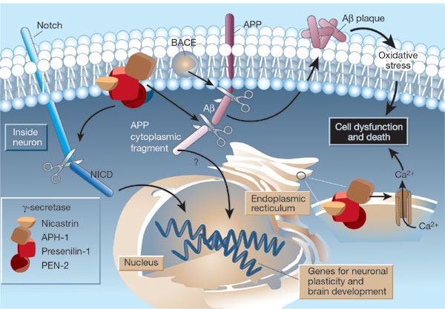
Early-onset Alzheimer’s Disease
Familial early-onset Alzheimer’s Disease is inherited in an autosomal dominant fashion and commonly caused by mutations in 1 of 3 genes: presenilin 1, 2, and amyloid precursor protein (APP).
The presenilin proteins 1 and 2 are part of the gamma-secretase complex that cleaves beta amyloid from APP.
Mattson, M. Nature. 422, 385-387 (2003)
Image retrieved from http://www.nature.com/nature/journal/v422/n6930/fig_tab/422385a_F1.html on July 25, 2013
Permission received from Nature Publishing Group.

Slide 24
Enrique chooses to undergo a direct-to-consumer genetic testing option to test for the currently known mutations (found in 50 families) in the PSEN1, PSEN2, and APP genes that can increase risk for familial early onset Alzheimer’s Disease.
Selected PSEN1 Pathologic Allelic Variants
DNA Nucleotide Change | Protein Amino Acid Change
236C>T | Ala79Val
265G>T | Val89Leu
338T>C | Leu113Pro
415A>G | Met139Val
436A>C | Met146Leu
509C>T | Ser170Phe
548G>T | Gly183Val
697A>G | Met233Val
767A>C | Tyr256Ser
806G>A | Arg269His
839A>C | Glu280Ala
1175T>C | Leu392Pro
1292C>A | Ala431Glu
4,555bp deletion of exon 9 | Nat Med. 1999 Oct;5(10):1090.
He is found to have a mutant allele: Met146Leu in the PSEN1 gene which is completely penetrant for early-onset Alzheimer’s Disease.
Table adapted from http://www.ncbi.nlm.nih.gov/books/NBK1236/ on July 24, 2013

Slide 25
Class poll: Recent studies have revealed that recurrent concussions and traumatic brain injury hastens the onset-time of Alzheimer’s Disease. If you were Enrique and Valentina, Joaquin’s parents, would you…
advocate for no interventions
genetically test Joaquin as a minor for the PSEN1 mutation
not allow him to play football, hockey, soccer, and other contact sports growing up
genetically test Joaquin at age 18 for the PSEN1 mutation
Notes:
ask for a volunteer for most common and least common – share their thinking process

Slide 26
American College of Medical Genetics Position Statement
After an initial genetics consultation, the patient and the primary care doctor should receive a written summary of the consultation that includes the recommendation to contact the genetics unit for new advances…
Notes:
putting the onus on the patient/primary care doctor.

Slide 27
American College of Medical Genetics Position Statement
“Early professional statements recommended that predictive genetic testing of minors be considered only if effective medical interventions were available to treat, prevent, or retard the course of the disease…the general consensus was to discourage if not proscribe predictive genetic testing of minors for late-onset conditions…the AAP and the ACMG continue to support the traditional professional recommendation to defer genetic testing for late-onset conditions until adulthood.”
Genetics in Medicine, 15(3): 234-245.
Notes:
putting the onus on the patient/primary care doctor.

Slide 28
Incidental Findings
Via DTC genetic testing, Enrique found out that he is a carrier for the S549N CFTR mutation, a common CFTR mutation found in Hispanic American individuals, conferring a risk for cystic fibrosis.
An incidental finding is a finding concerning an individual that has potential health or reproductive importance discovered beyond the aims of the original clinical question.

Slide 29
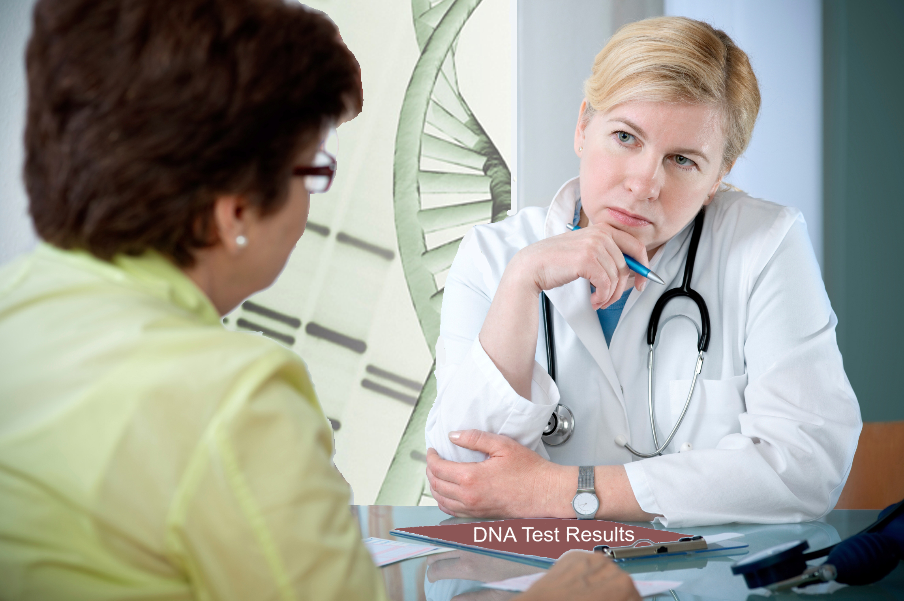
Incidental Findings, cont’d
Companies like 23andMe are responding to what individuals (consumers) desire: more information about diseases, even if these diseases do not have a cure or effective prevention. These practices can lead to incidental findings.
2010 study in Health Economics: 88% of people said they would like to take a test that could foretell their odds of developing arthritis or Parkinson’s Disease, despite lack of treatment.
?
Image retrieved from http://blogs.cdc.gov/genomics/2012/07/26/think-after-you-spit/ on July 24, 2013
Notes:
An incidental finding is a finding concerning an individual that has potential health or reproductive importance discovered beyond the aims of the original clinical question. Historically, incidental findings have been discussed in the context of research participants (Brief et al, Minn J Law Sci Tech, 2012). For example, while surveying the genetic variation of a specific population for one disease (like diabetes), a researcher may find an allelic variation in some individuals that puts them at risk for a different disease than the one under investigation, such as atherosclerosis.
Direct-to-consumer genetic testing panels are currently available, like 23andMe, which test for many common disease associated mutations and polymorphisms, not just mutations associated with one particular disease in a clinical scenario, such as a family history of early onset breast cancer or Huntington’s Disease. These companies are responding to what individuals and consumers want: more information, even if learning that information does not have a cure or effective prevention: a 2010 study in Health Economics 88% of people said they would like to take a test that could foretell their odds of developing arthritis or Parkinson’s Disease.

Slide 30
Class poll: If the frequency of cystic fibrosis in the medical student population is 1/2500, what is the frequency of heterozygote carriers for cystic fibrosis in this population?
0.0004
0.02
0.04
0.96
0.98

Slide 31
Using our Hardy-Weinberg framework
From the question…q² = 1/2500 = 0.0004
q² = 0.0004, thus q = 0.02
p + q = 1, thus p = 0.98
p² = 0.96
2pq = 2(0.02x0.98) = 0.04
how many people in this class would be carriers?
~ 7
Notes:
~7 (for a class size of 180)

Slide 32
If Enrique and Valentina would like to have a another child..
Their genetic testing would be different following this incidental finding.
The next recommended step would be carrier testing for Valentina.
expanded panel of CFTR mutations vs. basic panel of CFTR mutations
If Valentina is found to be a carrier, then prenatal or preimplantation testing may be pursued.
Notes:
Because Valentina is from the non-majority population in terms of cystic fibrosis risk, a broader genetic testing approach would be necessary to achieve a suitable mutation detection rate for her.

Slide 33
In conclusion…the best of both worlds?
My 46: University of Washington research project
  Repository for genetic information
  registrants can select “preferences” about what information they want to
  learn from their genomes.
These preferences are modifiable as one ages and can adjust to clinical questions that the individual and their doctor ask throughout a lifetime.
Image retrieved from https://www.my46.org/demo/next-steps on July 24, 2013. Permission received from University of Washington.
Notes:
My 46: the 46 comes from the number of chromosomes in the genome
No financial ties to any of these companies.

Slide 34
Summary
2 types of Genetic Testing: DTC and Genetic Counselor
Variants of Unknown Significance
Duty to Recontact
Incidental Findings

