Slide 1
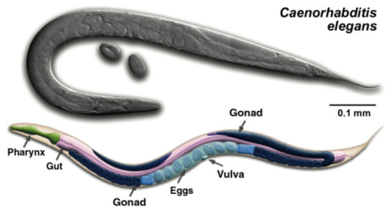
Lesson One: What can we learn from worms?
How the nematode C. elegans maintains balance in a changing environment.
Reprinted with permission from Z. Altun & C. Crocker (wormatlas.org)

Slide 2
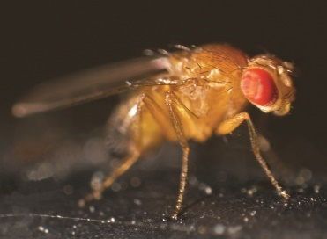
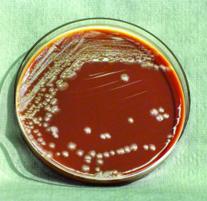
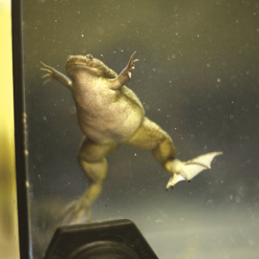
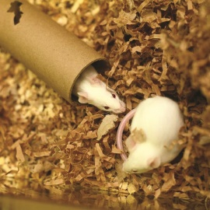
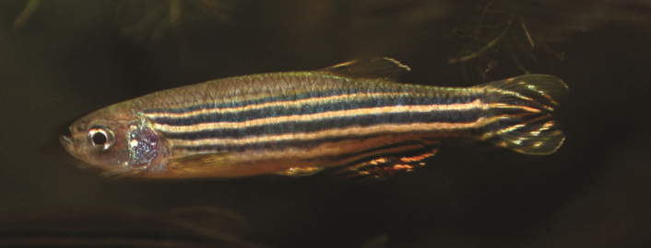
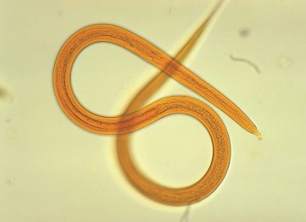
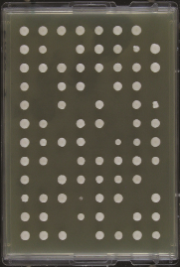
C. elegans as a model organism
What are model organisms?
There are many types of models—plants, animals, microbes—which are living systems used to study biological processes. Many biological processes are nearly the same in all living things.
Why study C. elegans?
They are small, transparent, reproduce quickly, and are relatively inexpensive to house.
They are very well-studied so there is already a wide body of knowledge about them.
Although simple looking, they have complex organ systems (digestive, excretory, reproductive, nervous, etc.) that have processes similar to those of humans.
Notes:
A lesson about animal models titled Why use Animals in Research? can be found on the nwabr.org website at: https://www.nwabr.org/teacher-center/animals-research#lessons
All pictures available for use as credited:
Fruit fly: Wikimedia Commons, Mr. Checker, 2009
Yeast: Wikimedia Commons, Masur, 2009
Frog and Mice: Understanding Animal Research Copyright 2007
Zebrafish: Wikimedia commons 2007
C. elegans: Centers for Disease Control and Prevention/ Dr. Mae Melvin, 1974
Bacteria: Centers for Disease Control and Prevention/Pete Seidel, 2010

Slide 3
Lesson One: What can we learn from worms?
Today we will learn about…
Worm Basics
Worm Plate Orientation
Worm Rules
Tips on observing wild type and mutant worms
Drawing to scale
Then we will…
Compare Notes
Discuss Wows! and Wonders?

Slide 4
Worm Basics
Nematodes:
Are the most abundant multi-cellular organisms in the world (estimated at one to ten million different species)
Live in soil or as parasites in plants, animals, or insects
C. elegans:
Range in length from 0.25 to 1.2 mm
Have two sexes: hermaphrodite (959 cells) and male (1031 cells)
In the lab, feed on bacteria such as E. coli growing on agar plates
Graphic reprinted with permission from Z. Altun & C. Crocker (wormatlas.org)

Slide 5
More Worm Basics
Nematodes:
Reach sexual maturity at 3 days
Live up to 3 weeks
Have two sexes – hermaphrodites (XX) and males (XO)
XX can self-fertilize or mate with males; but not each other
Produce over 300 offspring in a lifetime
Have 3 distinct life stages:
Egg → Larvae (L1, L2, L3, L4) → Adults

Slide 6
Orientation to the Worm Plate
Agar (nutrients for E. coli; salt)
Worm
E. coli bacteria
(food for worms)
Notes:
The dark region of food in the center of the plate may or may not be visible to students, depending on how long ago the worms were transferred to the plate and how much food has already been eaten. Explain to students that this is where the food originally was, which might account for the location of many of the worms.

Slide 7
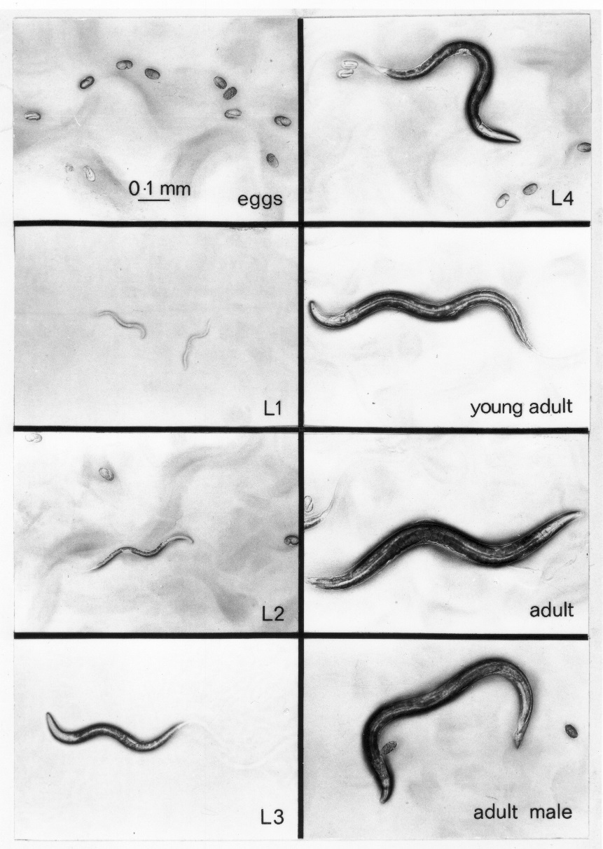
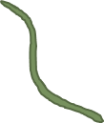
Life Stages: What will you see?
Lifecycle of C. elegans
Adults
( ~ 1 mm)
L4
18 hours
Egg
8 hours
9 hours
L1
L3
8 hours
12 hours
L2
Photo credit J. Sulston. Used with permission.
Notes:
C. elegans Life Stages John Sulston, University of Manchester. Dr. Salston worked with Sydney Brenner and made this photo montage in the 1970s. Salston and Brenner won a Nobel Prize in 2003 for their work with C. elegans.

Slide 8
Lifecycle of C. elegans
Adults
( ~ 1 mm)
L4
18 hours
How long from egg to adult?
Egg
8 hours
9 hours
55 hours =
2 days + 7 hours
L1
L3
8 hours
12 hours
L2

Slide 9
Lab Safety
During the next few days, you will be conducting and investigation with C. elegans.
What are some safety considerations?
Wear gloves when handling the worm plates, and don’t touch your eyes or face with your gloved hands. Wash your hands after removing gloves.
You may be using an open flame to sterilize a metal spatula. Good lab practices should be used around the flame and with the hot metal spatula.
Diluted glycerol (glycerin) is used in a later lesson. This is a stable chemical that might cause mild irritation if applied to skin. Wear gloves when working with it, and don’t touch your eyes.
Remember: C. elegans and the bacteria used for their food are harmless to humans, but
it is always important to maintain good lab safety practices.
Notes:
Although C. elegans and the bacteria used as worm food are harmless to humans, it is a good safety practice to always wear gloves when handling biological samples. In addition, you may contaminate the plates by transferring worms, bacteria, or fungi from a different plate or the environment.

Slide 10
Worm Rules
Store the plates with the agar side facing down so that condensation doesn’t drop onto the plate.
Flip the plate over to look at it under the microscope. You may need to remove the clear cover to see them well, but only leave the cover off for a few minutes.
Do not leave the worms on the microscope in the light for more than a few minutes, as they can get too hot.
Notes:
Although C. elegans and the bacteria used as worm food are harmless to humans, it is a good safety practice to always wear gloves when handling biological samples. In addition, you may contaminate the plates by transferring worms, bacteria, or fungi from a different plate or the environment.

Slide 11
Tips for observing worms
Some things to look for:
What life stages are present (adult, larvae, or egg)?
Where are worms on the plate (on agar, on food, near edge of plate)?
What are the worms doing (moving, not moving, feeding)?
Watch these videos showing…
eggs, larvae and adults: http://www.youtube.com/watch?v=ToLYgB_bxqM&feature=player_detailpage
worms responding to touch: https://www.youtube.com/watch?v=olrkWpCqVCE
Notes:
Another good video resource can be found here:
http://www.openworm.org/getting_started.html
What: Students should be able to distinguish adults and larvae. They may also have eggs on their plates.
Where: They should look on the food, the agar, and around the edges.
What: The worms may or may not be moving. If they are on the food they may move very little because they’re eating. If they are straight and not moving at all, they may be dead.

Slide 12
Drawing what you see and drawing to scale
Place a worm plate on the stage of the scope, agar side down. Take off the lid.
At a low magnification, find where the worms are located on the plate.
At high magnification, find a place on the plate that has worms of different sizes.
Place the 4 mm x 4 mm grid under the worm plate, beneath the worms you are looking at so you can see both the worms and the grid.
Draw what you see in the grid on the microscope on the 8 cm x 8 cm grid in Student Lab Sheet 1. Each mm in size on the microscope is 2 cm in the drawing.

Slide 13
Discussion Wows! and Wonders?
Lesson One
Did you see all the life stages on your plate?
How are the wild and mutant worms similar or different?
What evidence indicates that the worms react to their environment?
Notes:
Students may not notice any differences between the wild and mutant worms, or the differences they see may be due to differences in the age of the worms on each plate.

Slide 14
Lesson Two: Worms in a changing environment
Today we will learn about…
Chunking/transfer of worms
Preview of Data Tables
Make 15-minute observations of worms
Environmental factors affecting worms
Then we will…
Compare Notes
Discuss Wows! and Wonders?

Slide 15
Life Stage Guide
Lifecycle of C. elegans
Adults
( ~ 1 mm)
L4
18 hours
Egg
8 hours
9 hours
L1
L3
8 hours
12 hours
L2
Photo credit J. Sulston. Used with permission.
Notes:
C. elegans Life Stages John Sulston, University of Manchester. Dr. Salston worked with Sydney Brenner and made this photo montage in the 1970s. Salston and Brenner won a Nobel Prize in 2003 for their work with C. elegans.

Slide 16
Transferring worms by chunking
Flip
Flip
Wild
Low
Wild Type worms on a plate
Cut agar into 2 pieces
Move one chunk to
low-salt plate
Wild
High
Move one chunk to high-salt plate
Flip
Flip
Repeat this by transferring the mutant worms onto low and high salt plates.

Slide 17
15-Minute Observations
Things to look for after 15 minutes…
Life stages on the plate (eggs, larvae, and adults)
Evidence that worms have moved: Worms are no longer at the drop site;
worms are clearly moving; there are worm tracks in the food
Evidence that worms are eating: Worms are in the food; worms tracks through the food, worms may not be moving if in food
Notes:
Students may mention changes in temperature, amount of moisture, pH of soil, amount of food available, etc. Encourage them to discuss what effects these changes may have on worms.
Ask students what might happen to worms if they moved into an area where the concentration of salt or sugar is higher than they are used to. Do they think that this is likely to happen to worms in the wild?
Explain that they are going to transfer wild type and mutant worms to low (normal) and high salt plates and will observe the worms over the next 48 hours.

Slide 18
24 and 48 Hour Observations
Things to look for after 24 and 48 hours…
Evidence that worms are growing: There are more large larvae or adults than on previous day; eggs at the drop site are no longer there because they have hatched
Evidence that worms are reproducing: There are eggs in places other than the drop spot
Notes:
Students may mention changes in temperature, amount of moisture, pH of soil, amount of food available, etc. Encourage them to discuss what effects these changes may have on worms.
Ask students what might happen to worms if they moved into an area where the concentration of salt or sugar is higher than they are used to. Do they think that this is likely to happen to worms in the wild?
Explain that they are going to transfer wild type and mutant worms to low (normal) and high salt plates and will observe the worms over the next 48 hours.

Slide 19
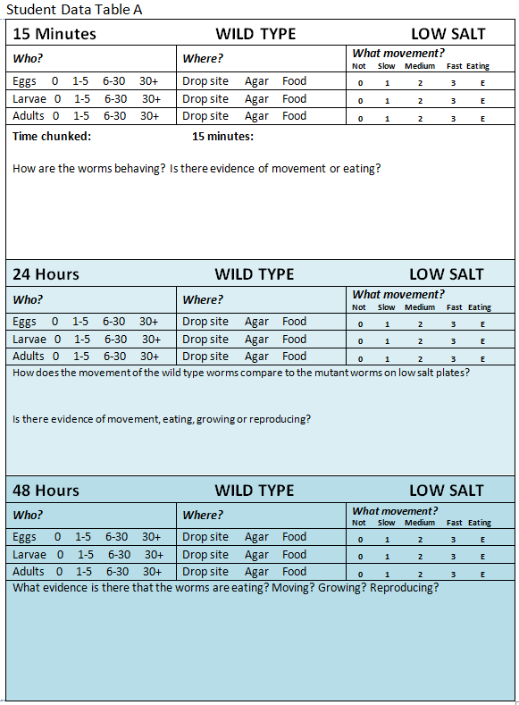
Observation
Data Table
(at 15 minutes for WILD TYPE worms on a LOW SALT plate)

Slide 20
Lesson Two: Worms in a changing environment
What environmental changes do you think nematodes experience throughout the day and throughout the year?
Is it likely that worms in the wild would experience areas of changing salt or sugar concentration?
What do you think would happen to the worms?
Notes:
Students may mention changes in temperature, amount of moisture, pH of soil, amount of food available, etc. Encourage them to discuss what effects these changes may have on worms.
Ask students what might happen to worms if they moved into an area where the concentration of salt or sugar is higher than they are used to. Do they think that this is likely to happen to worms in the wild?
Explain that they are going to transfer wild type and mutant worms to low (normal) and high salt plates and will observe the worms over the next 48 hours.

Slide 21
Discussion Wows! and Wonders?
Lesson Two
How do wild type and mutant nematodes respond when transferred to low and high salt plates?
How does the change in environment affect their behavior and function?

Slide 22
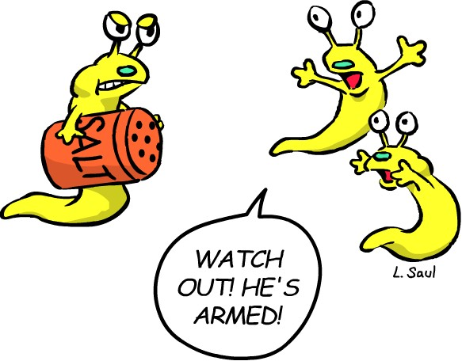
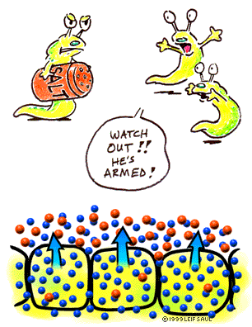
Lesson Three: Entrance Activity
Using pictures and words, describe what happens when…
a fresh water fish is put into a salt water aquarium
or
salt is poured on a slug
Used with permission: Leif Saul / BiologyInMotion.com
Notes:
Leif Saul, University of Colorado

Slide 23
Lesson Three: Worms and Salt
Today we will…
Learn about the role of glycerol in water balance
Set up the dialysis experiment
Make 24-hour observation of worms
Analyze the results of the dialysis experiment
Then we will…
Compare Notes
Discuss Wows! and Wonders?

Slide 24
A Difference between Wild Type and Mutant Worms
2000
1500
Glycerol content of wild type & mutant worms in low salt
Worm
Glycerol
(nmol/ mg protein)
1000
500
0
WT Mutant
Data from this figure originally published in PLoS Genetics in 2011.
Notes:
Data from this figure were originally published in PLoS Genetics in 2011.

Slide 25
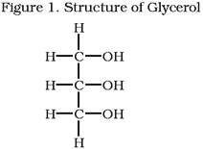
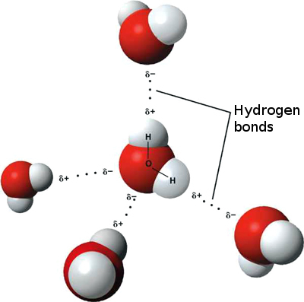
What is the function of glycerol?
Figure 2. Hydrogen bonding in water
Glycerol (Figure 1) is made of carbon, oxygen, and hydrogen. It binds to water through hydrogen bonds, in the same way that water molecules bind to each other (Figure 2). The hydrogen bonding occurs between the hydrogen atoms of each –OH (hydroxyl) group on glycerol with the oxygen atoms of the water molecules.
Permission for use granted through Wikimedia Commons GNU Free Documentation License
Notes:
Permission granted through Wikimedia Commons GNU Free Documentation License
http://commons.wikimedia.org/wiki/File:3D_model_hydrogen_bonds_in_water.jpg

Slide 26
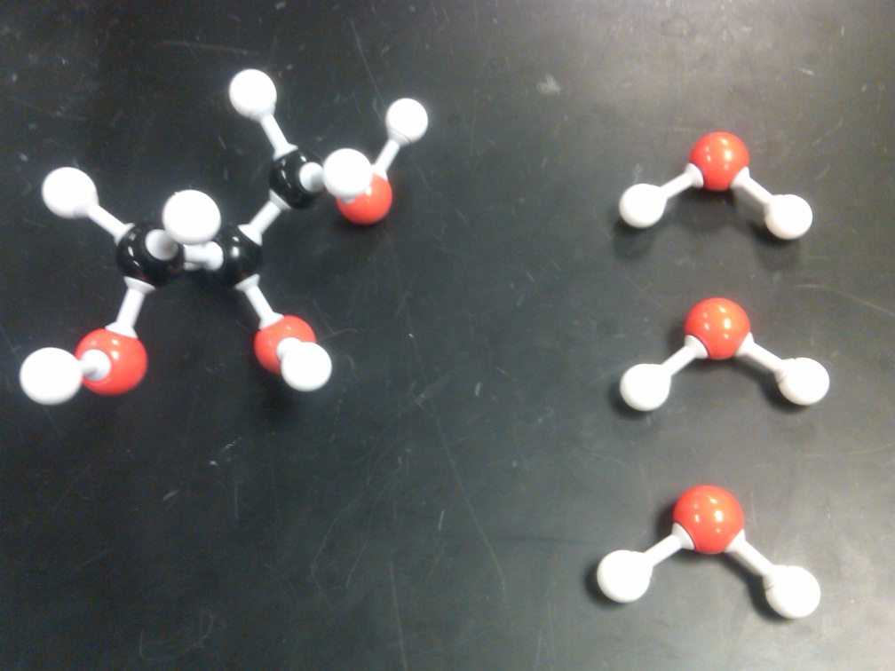
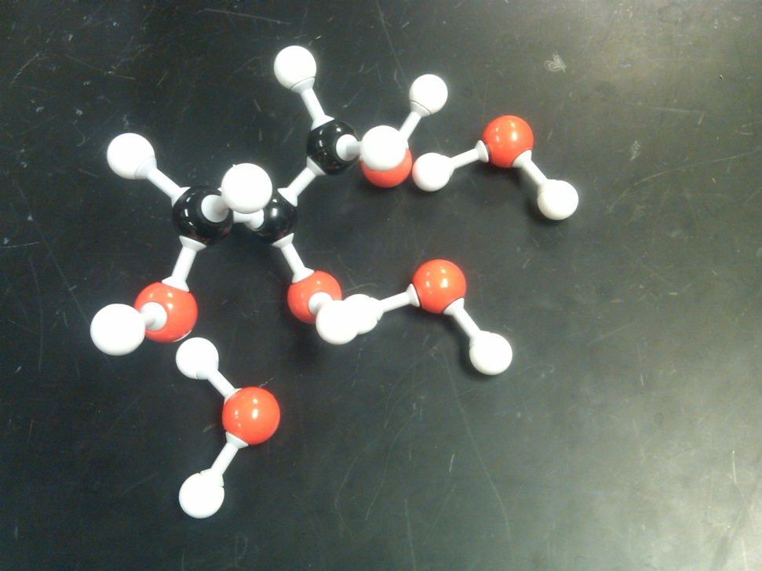
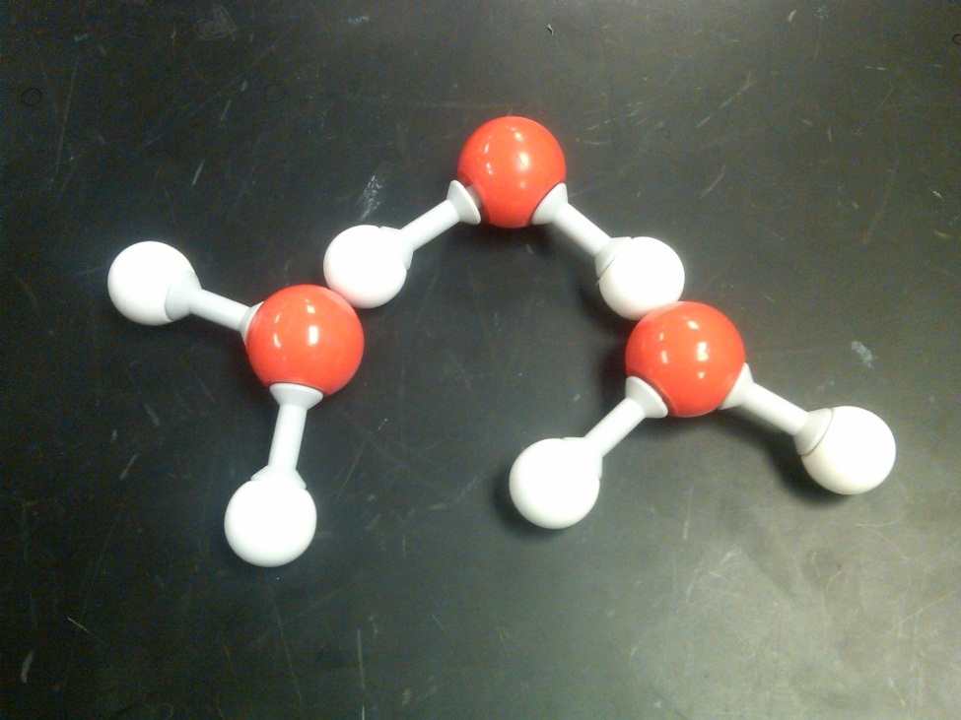
Water
Carbon
Oxygen
Hydrogen
Oxygen
Hydrogen
Glycerol
Hydrogen bond
Hydrogen bond
Glycerol - Water
Water-Water
Notes:
Photo credit: Jeff Shaver

Slide 27
Lesson Three Student Directions:
Modeling the Effect of Glycerol on Worms in Salt
Materials (work in groups of four):
2 pieces of hydrated 1 inch dialysis tubing, about 10 inches long; 4 elastic bands
15 ml Low Glycerol Solution: 1.5% glycerol in 0.05 M NaCl
15 ml High Glycerol Solution: 50% glycerol in 0.05 M NaCl
2 large weighing trays
Crystalline Salt
Procedures:
Step 3: Seal the top end of the tube close to the liquid with a rubber band.
Step 5: Place each tube on a bed of NaCl (salt) in a flat tray and cover with additional salt. Label each tray with the name of the solution.
Step 2: Pour Low Glycerol Solution into one dialysis tube and High Glycerol Solution into the other.
Step 1. Seal one end of each dialysis tube with a rubber band.
Step 4: Weigh each tube and record the mass on Student Sheet 3.
Low glycerol
soln.
High glycerol
soln.
Step 6: Let dialysis tubes sit in salt for 30-60 minutes or overnight.
Step 7: Rinse dialysis tubes to remove salt and blot with a paper towel to dry. Then re-weigh, and record the mass of each on Student Lab Sheet 3.

Slide 28
Discussion Wows! and Wonders?
Lesson Three
How does glycerol prevent water from moving through the dialysis tubing into the salt?
How does this model help explain what is happening in different strains of C. elegans in different environments?

Slide 29
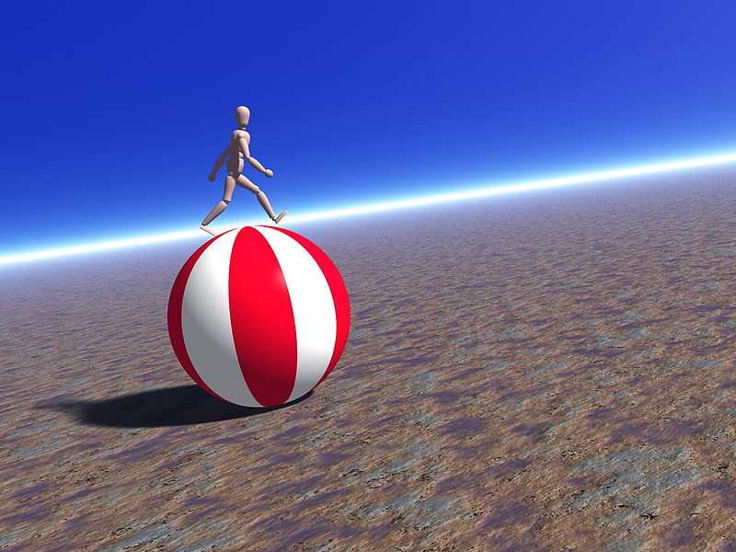
Lesson Four: Entrance Activity
Your body is constantly performing a balancing act that allows you to remain alive and functional as external conditions change.
Using pictures and words, describe how a warm-blooded animal (like you!) …
keeps warm in the cold
or
stays cool in the heat
© Nevit Dilmen / Wikimedia Commons
Notes:
©Nevit Dilmen / Wikimedia Commons
http://commons.wikimedia.org/wiki/File:Unstable_walk.jpg

Slide 30
Lesson Four: Using evidence
to develop an explanation
Today we will…
Make 48-hour observations of worms
Interpret data from scientific literature
Develop explanations for worm behavior in differing salt conditions
Then we will…
Compare Notes
Discuss Wows! and Wonders?

Slide 31
2000
1500
Graph A:
Glycerol content of wild type & mutant worms in low salt
Worm
Glycerol
(nmol/ mg protein)
1000
500
0
WT Mutant
Data from this figure originally published in PLoS Genetics in 2011.
Notes:
Data from this figure were originally published in PLoS Genetics in 2011.

Slide 32
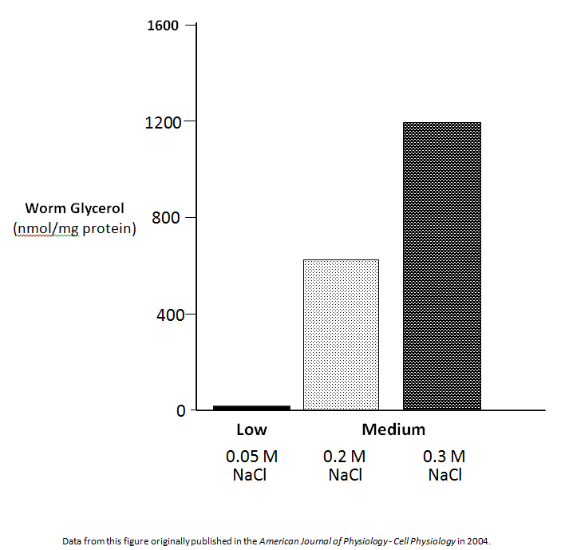
Graph B
Graph B:
Glycerol content of wild type worms grown on low and medium salt for 18 hours
Notes:
Data from this figure were originally published in PLoS Genetics in 2011.

Slide 33
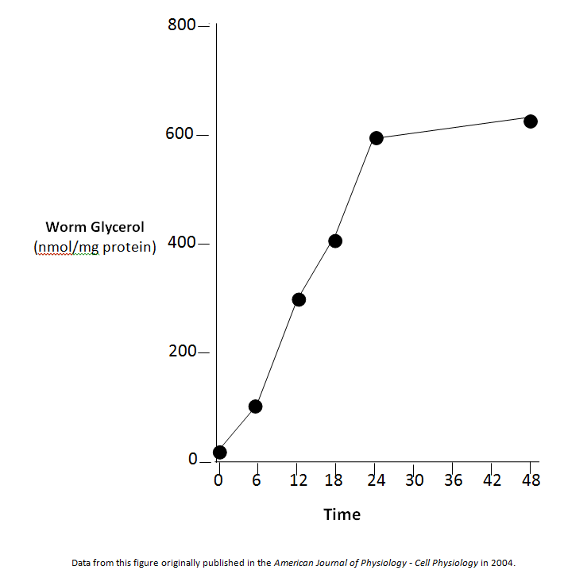
Graph C:
Glycerol accumulation over time in wild type worms grown on medium salt
Notes:
Data from this figure were originally published in PLoS Genetics in 2011.

Slide 34
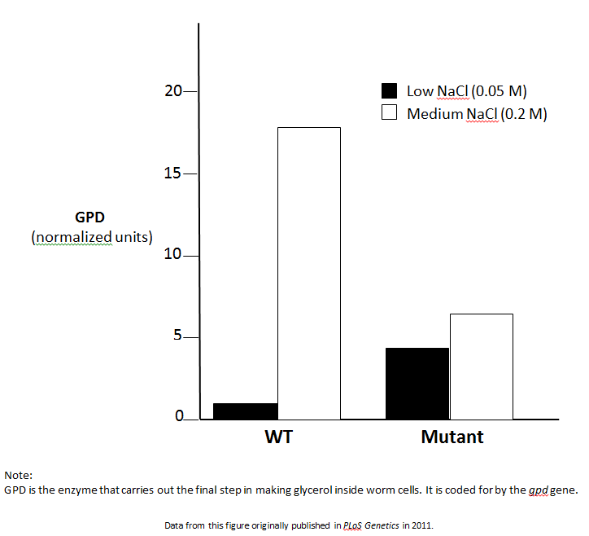
Graph D:
Accumulation of GPD in wild type and mutant worms grown on low or medium salt for 18 hours
Notes:
Data from this figure were originally published in PLoS Genetics in 2011.

Slide 35
Discussion Wows! and Wonders?
Lesson Four
How does C. elegans maintain homeostasis in a high salt environment?
Is it an advantage to always produce high levels of glycerol? Or is it better to be able to control glycerol production?

Slide 36
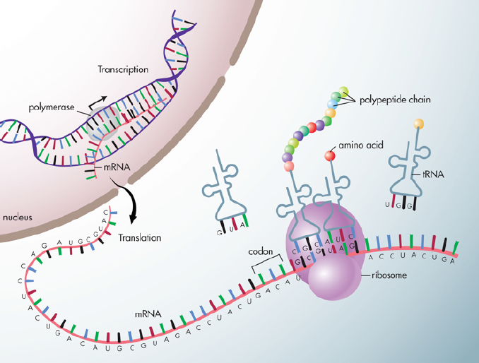
Lesson Five: How does a mutation affect C. elegans
in low and high salt?
Turn to a neighbor and describe your understanding of this graphic to each other
www.genome.gov
Notes:
http://www.genome.gov/dmd/img.cfm?node=Photos/Graphics&id=85252
Except where noted on the image details page, digital assets contained in this database are in the public domain and may be used, linked or reproduced without permission. If you use an image, please credit the listed source and/or author and add a link back to our homepage (www.genome.gov) when possible
Information on the National Human Genome Research Institute (NHGRI) Web site genome.gov is in the public domain. Public domain information may be freely distributed and copied, but, as a courtesy, it is requested that the National Human Genome Research Institute be given an appropriate acknowledgement: "Courtesy: National Human Genome Research Institute."
http://www.tokresource.org/tok_classes/biobiobio/biomenu/transcription_translation/ Blue one
http://www.theodora.com/genetics/images/transcription.jpg Grey with yellow

Slide 37
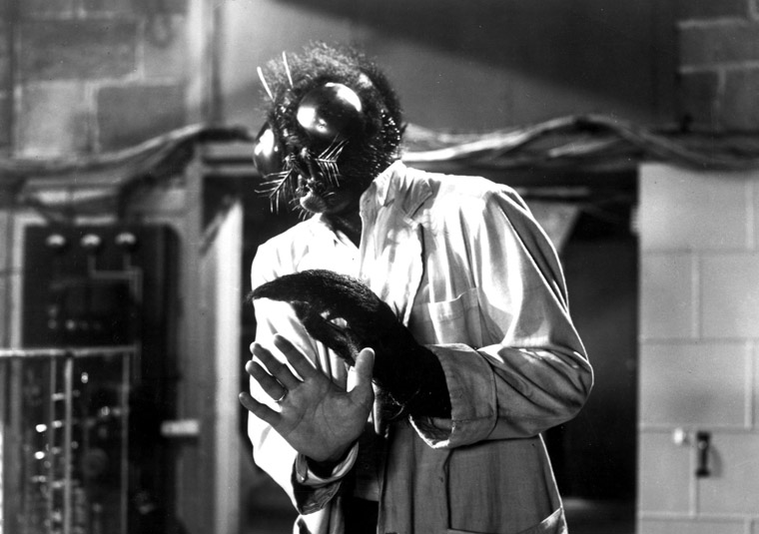
Consequences of Pop Culture Mutations
Mutations with a positive outcome:
After being contaminated with toxic waste, the Teenage Mutant Ninja Turtles use their powers for good.
Mutations with mixed outcomes:
Hated and persecuted by humans, X-Men still use their super-human traits (mostly) for good.
Mutations with a bad outcome:
The Fly, 1958, shows the horrible consequences of a fly’s DNA being integrated with that of a human
Permission for use granted through Wikimedia Commons
GNU Free Documentation License
Notes:
The Fly: http://3.bp.blogspot.com/_1zAt4AV4T7c/TLXL4vHkPHI/AAAAAAAAADc/m31Q8j-jQhA/s320/fly.jpg
X-men: http://ap2hyc.com/wp-content/uploads/2013/07/x-men-movies.jpg
TMNT: Wikimedia, free for use

Slide 38
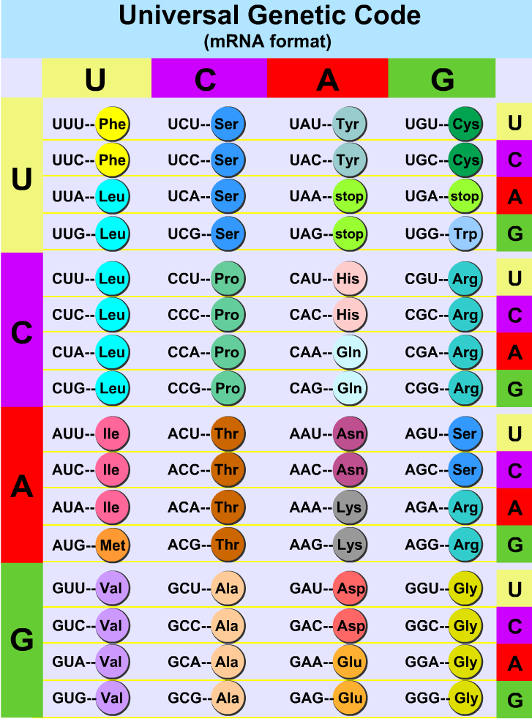
Universal Genetic Code
mRNA format
Source: Learn.Genetics.utah.edu
University of Utah

Slide 39
Discussion Wows! and Wonders?
Lesson Five
Describe one way in which a single nucleotide change in the DNA can have a dramatic effect on the protein coded for
Describe one way in which a single nucleotide change can have NO effect on the resulting protein

Slide 40
Assessment
Today we will…
Summarize what we learned during the worm experiment
Build models to demonstrate how the wild type and mutant worms responded to changes in their environments
Support claims with evidence and reasoning

Slide 41
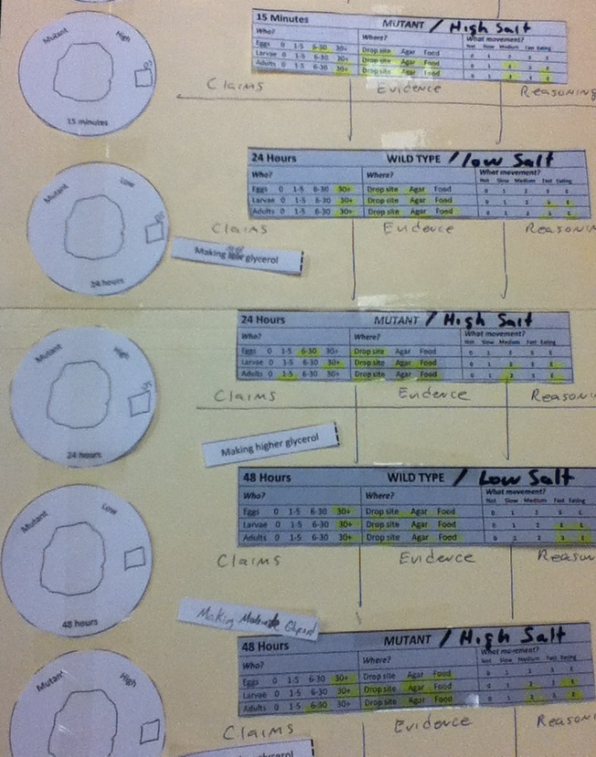
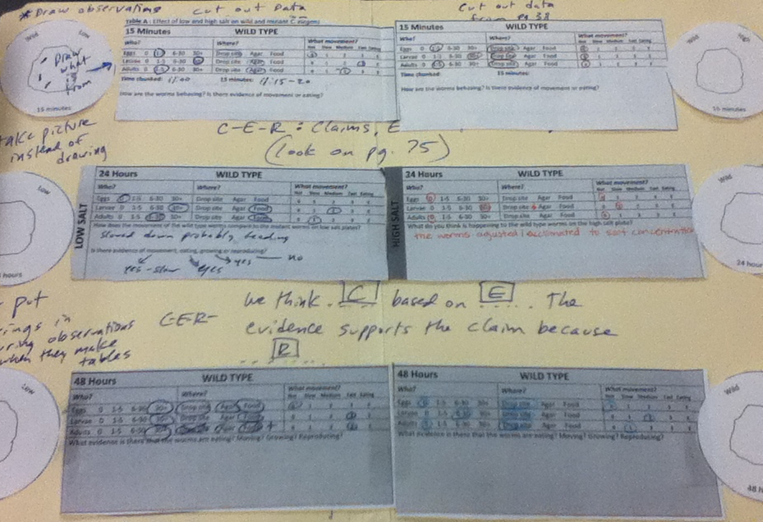
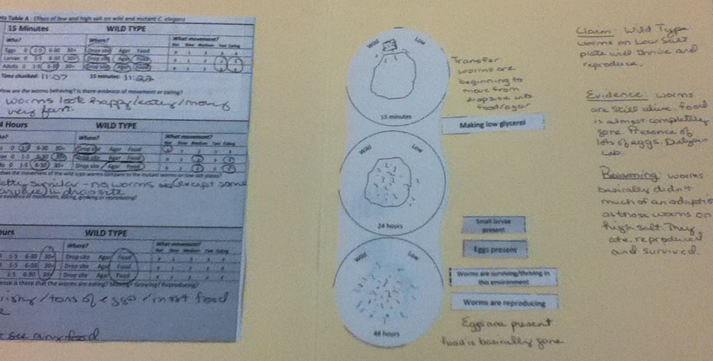
Assessment
Possible ways to set up your model:
Manila folder or large paper
Data tables
Paper worm plates
Make sure to leave room for your Claim – Evidence – Reasoning statements

Slide 42
Assessment
Possible Claims
Evidence/Observations
Making low glycerol
Making higher glycerol
Movement No movement
Larvae present Adults present
Eggs present
Worms thriving
Worms NOT thriving
Dialysis lab Graphs from L4
Worms are dead
Worms are reproducing
Eating Worms desiccated
Your choice!
Your choice!

Slide 43
Assessment
Claim – Evidence – Reasoning Statements
We think [insert your claim] based on [state your evidence]. The evidence supports the claim because [state your reasoning].
Example:
We think the mutant worms are reproducing on the high salt plates after 48 hours.
We saw eggs, small and large larvae and adults that weren’t there at the 15-minute observation. The literature shows that worms go from eggs to adults in under 3 days.
The evidence supports the claim because the only place the new life stages could come from is through reproduction of the original worms.

