Slide 1
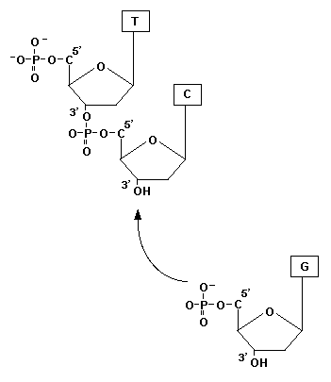
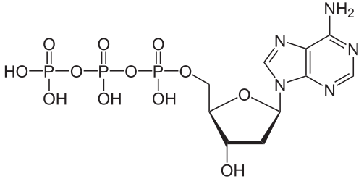
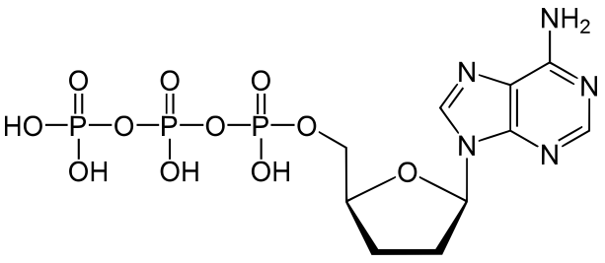
A
B
deoxynucleotide (dNTP)
-
dideoxynucleotide (ddNTP)
-

Slide 2
Sanger (dideoxy) DNA sequencing procedure overview
The reaction is a DNA synthesis reaction which involves:
a high concentration of regular deoxynucleotides
a low concentration of dye-labeled dideoxynucleotides
Each of the four dideoxynucleotides (A,T,C,G) is labeled with a different color dye.
After the DNA synthesis reaction, the DNA produced is imaged during electrophoresis to detect dye colors associated with band sizes.

Slide 3
Materials for DNA sequencing model
Blocks represent nucleotides
dNTPs
A = black
T = maroon
C = brown
G = white
Paper represents the template DNA, which we will be determining the sequence of.
ddNTPs (dye labeled)
A = orange
T = yellow
C = lt blue
G = green
The classroom represents a microtube, and each student represents a DNA polymerase.

Slide 4
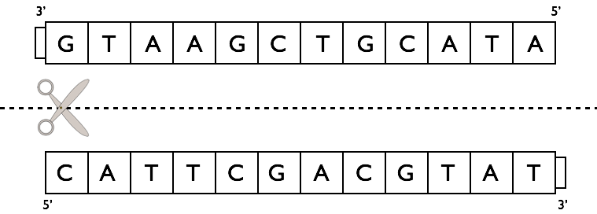
First steps in simulation
1) Make two copies of the primer; the sequence is 5‘ ATT 3’
Composed of deoxynucleotides. This would be modeled with a chain of 5’ black-maroon-maroon 3’
2) Denature the DNA by cutting/tearing the paper to separate the two strands.
In reality, this would be accomplished by heating the sample.
dNTPs
A = black
T = maroon
C = brown
G = white
ddNTPs (dye labeled)
A = orange
T = yellow
C = lt blue
G = green
3) “Anneal” the primer to the template strand

Slide 5
Modeling DNA synthesis
Roll die
If 1-5 is rolled, incorporate the appropriate deoxynucleotide at the next position
If 6 is rolled, incorporate the appropriate dideoxynucleotide at the next position, and synthesis of that chain is terminated
dNTPs
A = black
T = maroon
C = brown
G = white
Repeat above steps until a dideoxynucleotide is incorporated
ddNTPs (dye labeled)
A = orange
T = yellow
C = lt blue
G = green
Synthesize one strand until it is terminated, then denature those two and synthesize a second strand using another 5’ATT3’ primer. Synthesize carefully.
Keep your two newly synthesized DNA chains. After all synthesis is complete, the products of synthesis will be electrophoresed.

Slide 6
3’
5’
G
T
A
A
G
C
T
G
C
A
T
A
C
A
T
T
C
G
A
C
G
T
A
T
5’
3’
3’
5’
G
T
A
A
G
C
T
G
C
A
T
A
C
A
T
T
C
G
A
C
G
T
A
T
5’
3’
Notes:
each pair needs:
5 brown
5 maroon
8 black
8 white
2 each of orange, yellow, lt. blue, green

Slide 7
A
B
deoxynucleotide (dNTP)
-
dideoxynucleotide (ddNTP)
-

